Slide 1
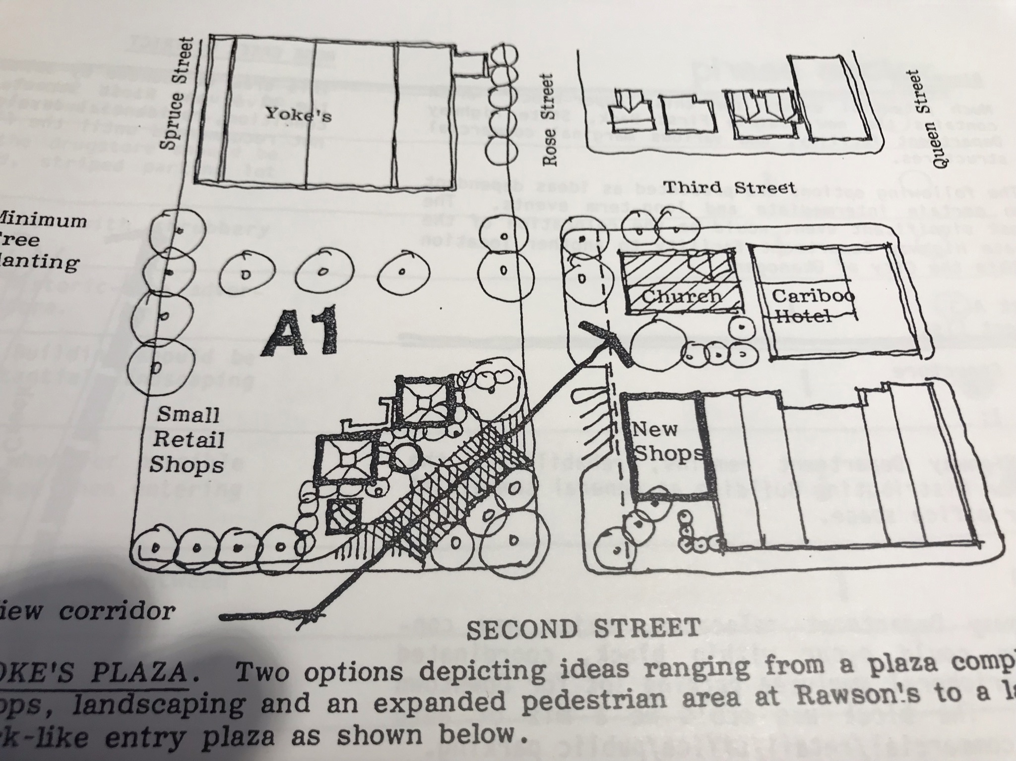
1981 city plan imagining pedestrian friendly walkways, trees, and a sightline featuring the rock church.

Slide 2
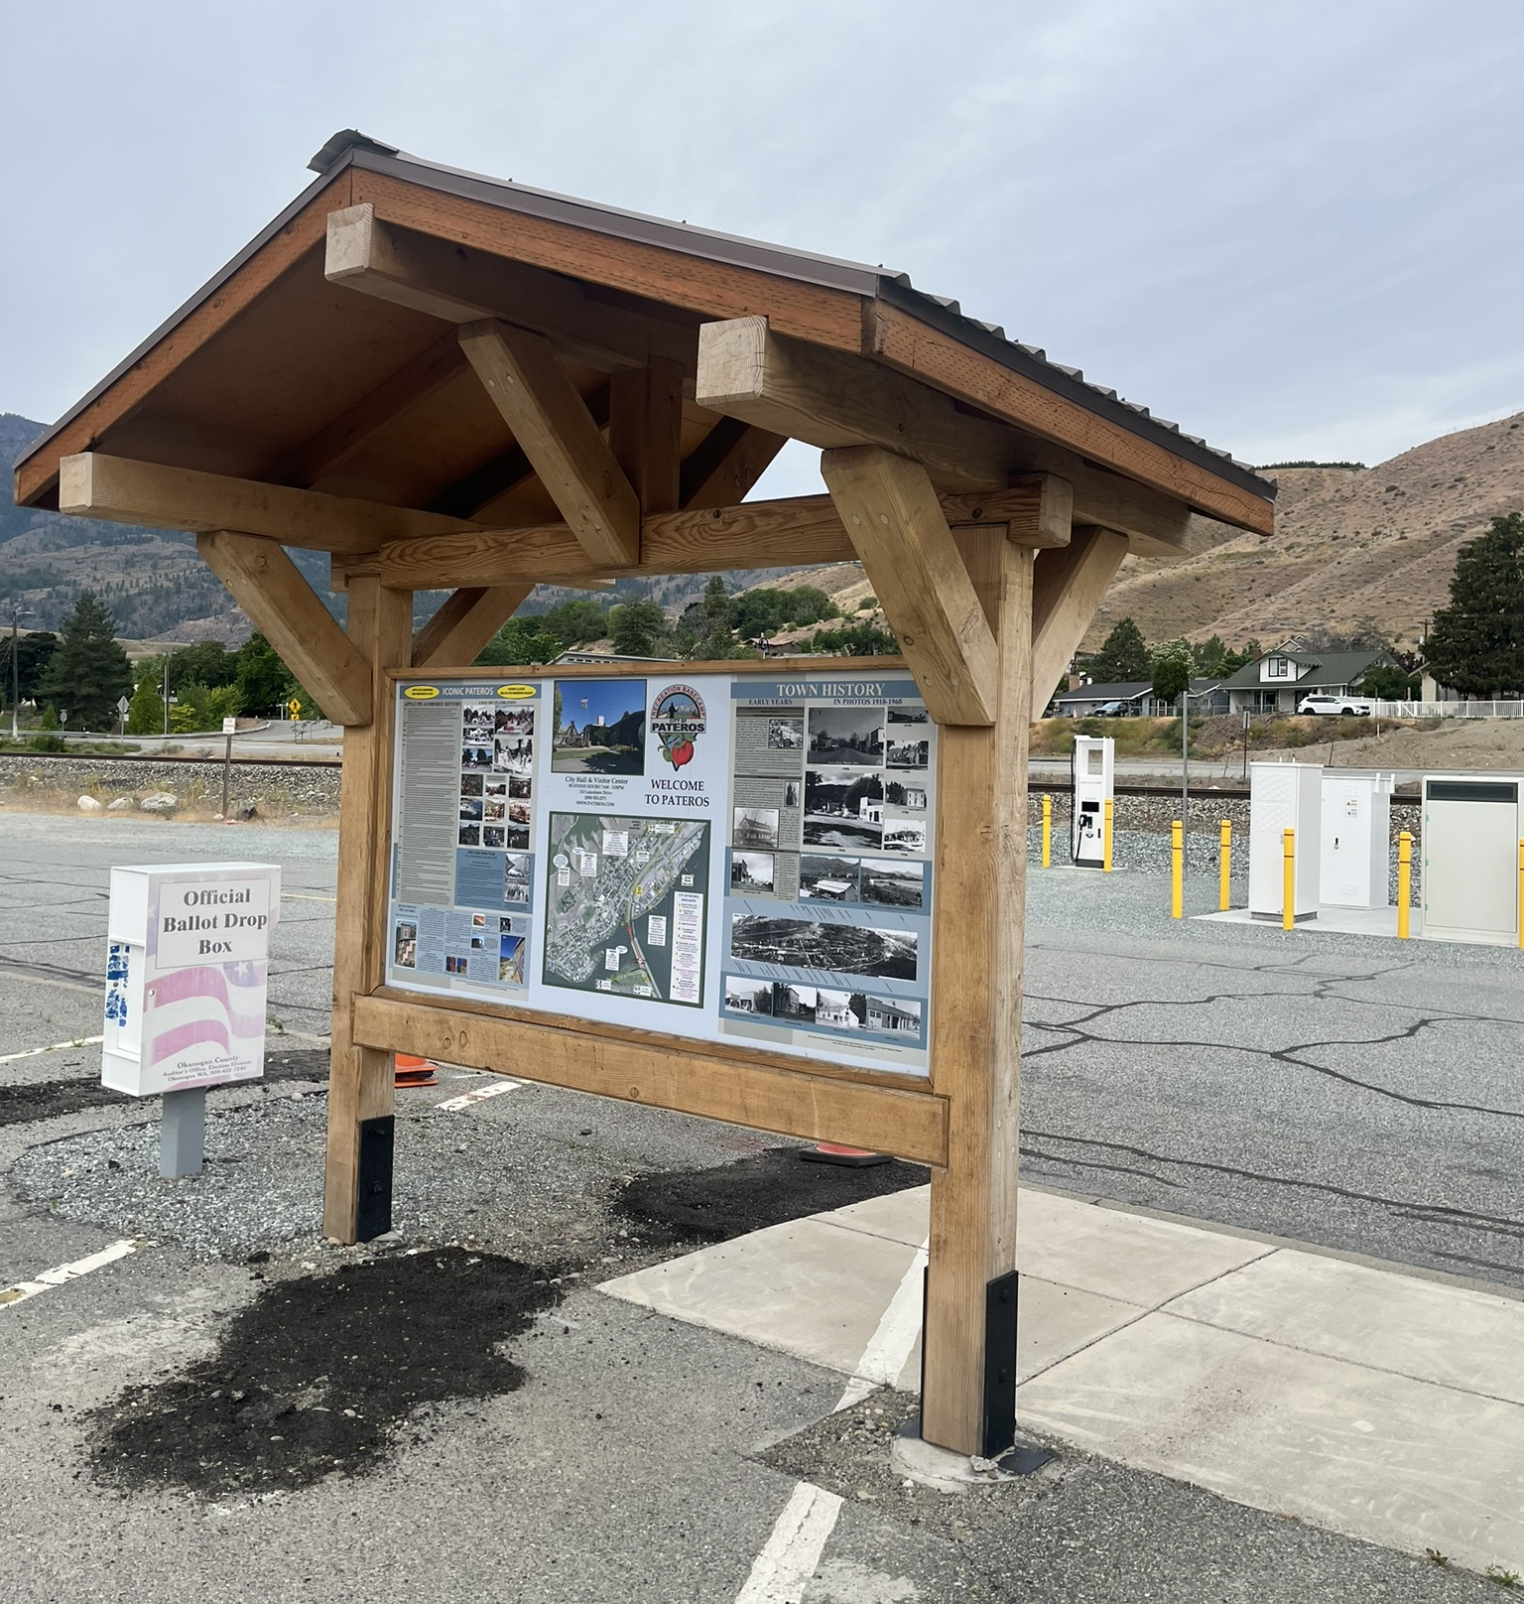
The Okanogan County Tourism Council has erected kiosks in all county towns except Okanogan. All kiosks are robust timber framed structures.

Slide 3
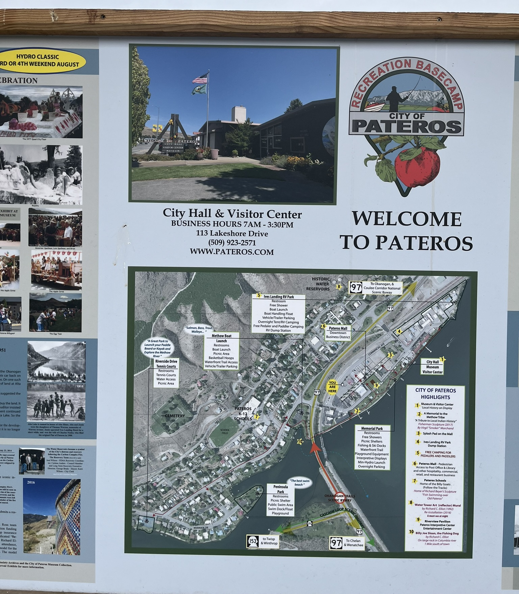
The kiosks will feature a narrative story of our community told in pictures and text designed by Earth and Sky Studios.

Slide 4
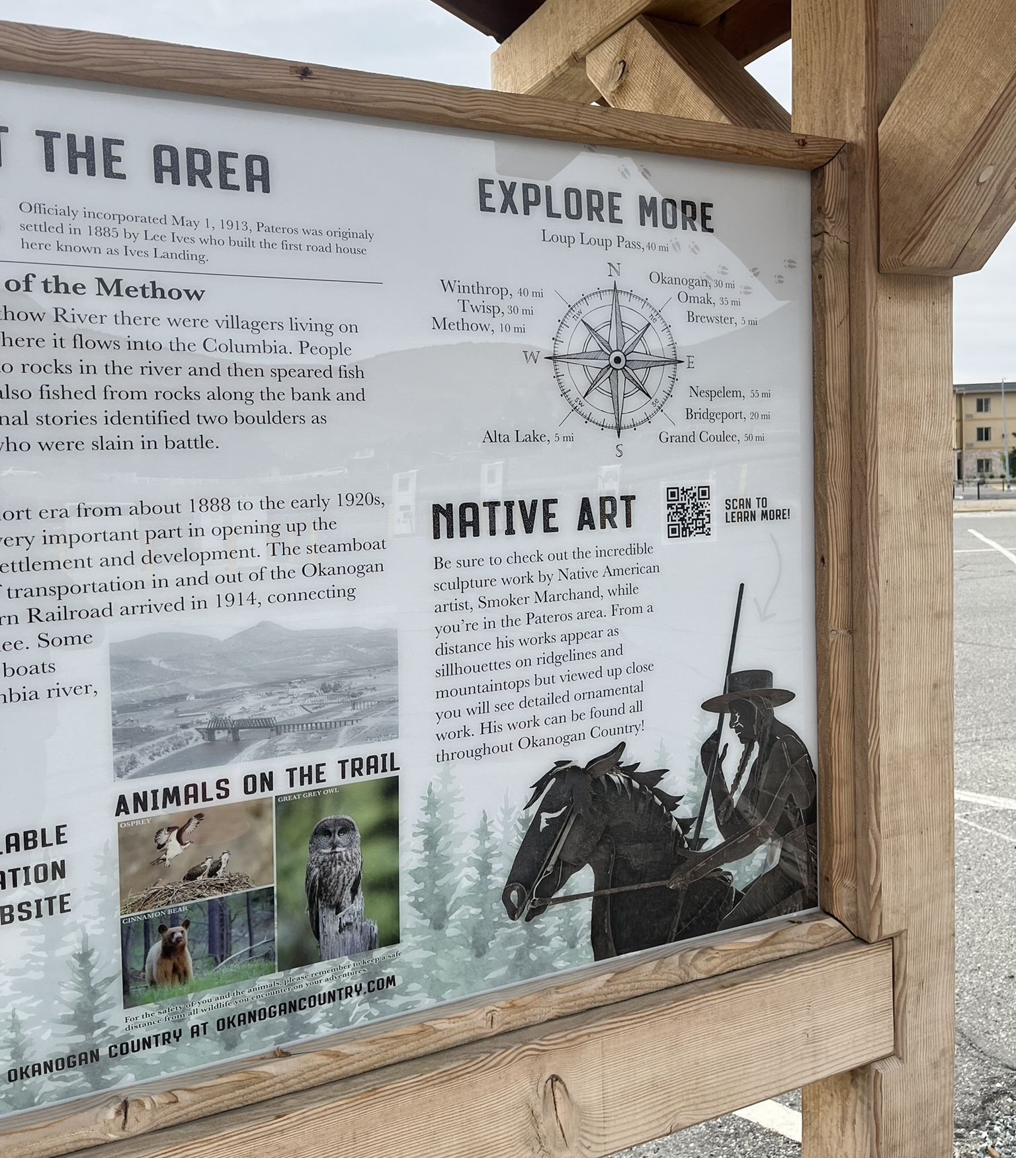
Graphic panels face toward the front and the back.

Slide 5
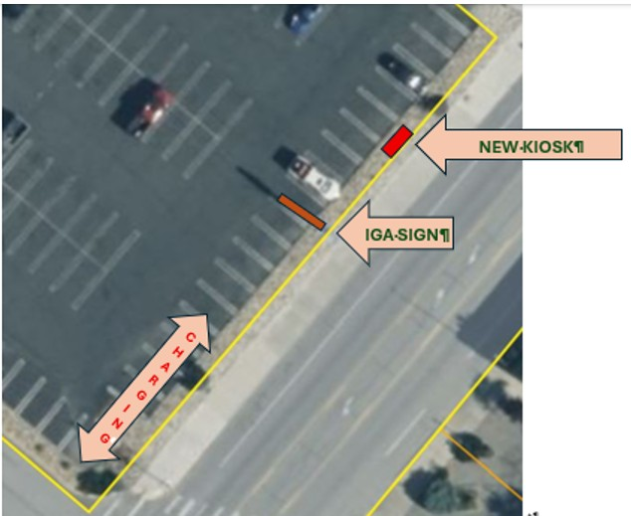
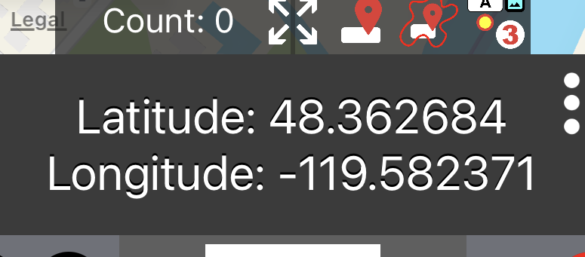
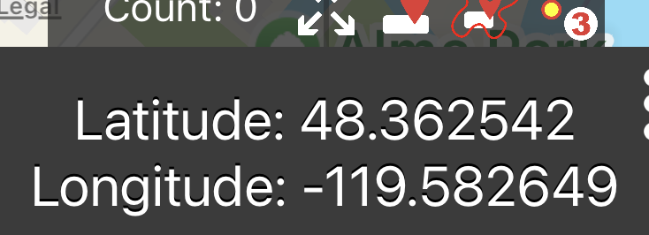
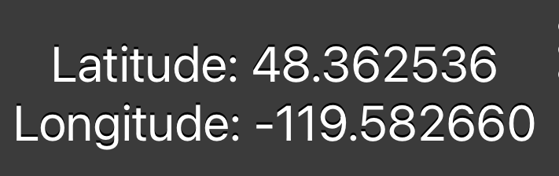
STREETSIDE CORNER OF WALL – 0 FT
NORTH CORNER OF MOU KIOSK AREA 66 FT FROM CORNER
SOUTH CORNER OF MOU KIOSK AREA 79 FT FROM CORNER

Slide 6
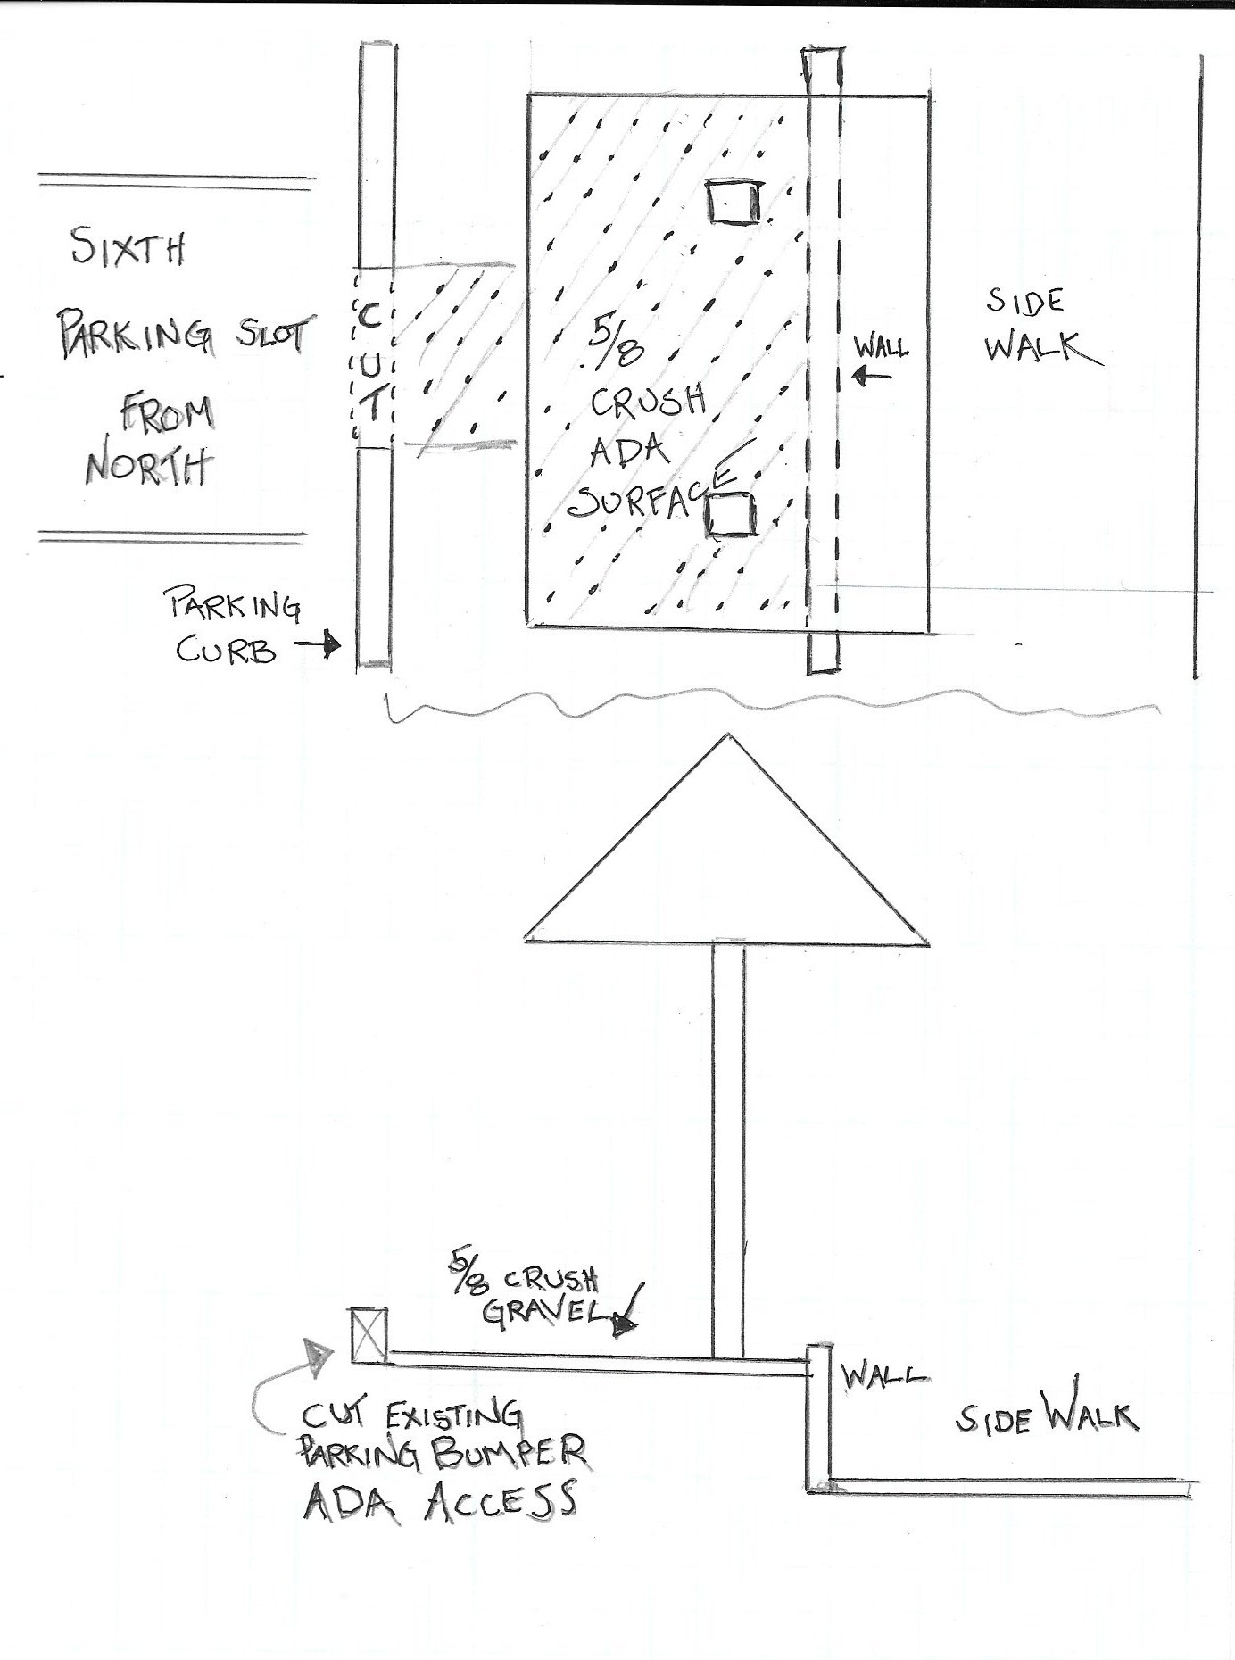
The kiosk will be located parallel to the sidewalk near the edge of the front wall. The curb at the 6th parking spot from the north must be cut. A 5/8 crush gravel pad surrounding the kiosk qualify for ADA access.

Slide 7
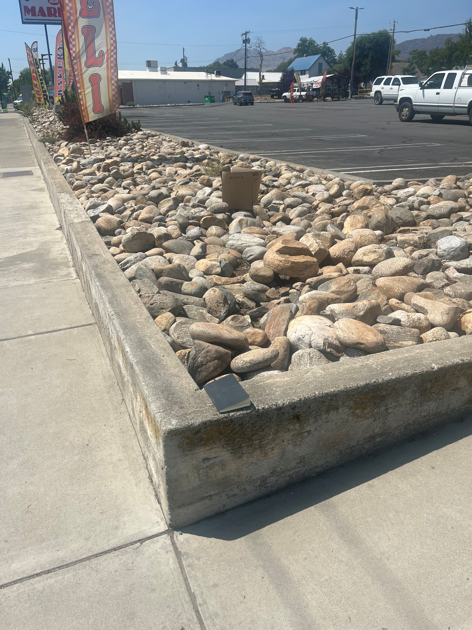

Slide 8
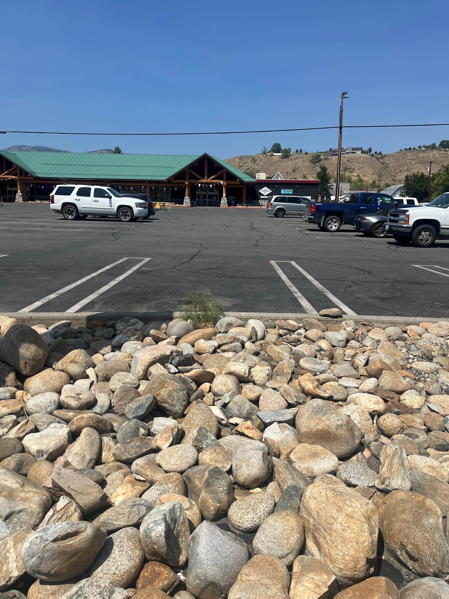
A memorandum of understanding between the IGA and the city must be secured to qualify for the tourism funding.

